Slide 1
CAUSES AND PREVENTION OF ROAD TRAFFIC CRASH
Paper Presentation
At
The 2024 Federal Road Safety Corps (FRSC) Mandatory Training Workshop for Drivers
By
A Idris
Route Commander
31-10-2024

Slide 2
Introduction
CAUSES OF RTC
Environmental, mechanical, and human causes
Implications, and strategies for preventing them
Trailers diverting through Offa Township
Preventing the potential related dangers.

Slide 3
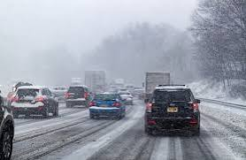
Classification of Causes of Road Traffic Crashes
1. Environmental Factors
Weather Conditions:

Slide 4

Road Infrastructure:

Slide 5

Lighting Conditions:

Slide 6
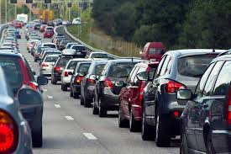
Traffic Congestion:

Slide 7
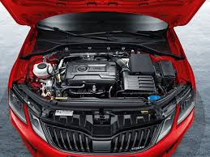
2. Mechanical Factors

Slide 8
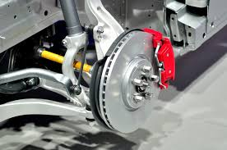
Brake Failure:

Slide 9
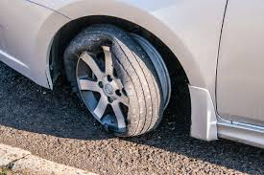
Tire Blowouts:

Slide 10
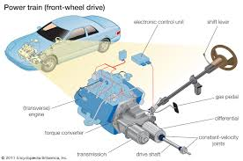
Steering and Suspension Issues:

Slide 11
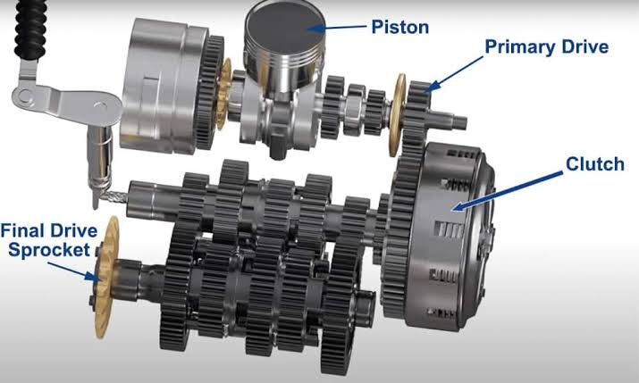
Engine and Transmission Failures:

Slide 12

Lighting System Failures:

Slide 13
3. Human Factors
Leading cause of road traffic crashes

Slide 14

Speeding:

Slide 15

Distracted Driving

Slide 16
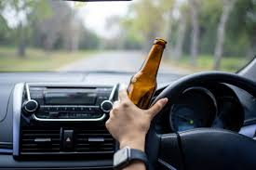
Driving Under the Influence of Alcohol and Drug

Slide 17

Fatigue

Slide 18
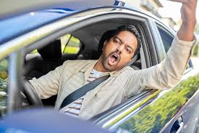
Reckless and Aggressive Driving

Slide 19

Loss of Lives and Injuries
FRSC; Nigeria recorded over 10,000 road traffic crashes in 2022, leading to 6,205 deaths and 27,112 injuries.

Slide 20

Economic Costs

Slide 21

Psychological Trauma

Slide 22
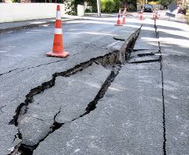
Impact on Infrastructure

Slide 23
Traffic Disruptions

Slide 24
Prevention of Road Traffic Crashes
Government action,
Driver responsibility,
And proper vehicle maintenance

Slide 25
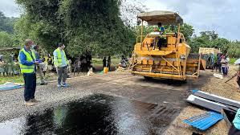
Improved Road Design and Maintenance

Slide 26
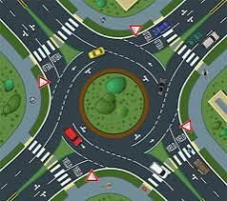
Traffic Management

Slide 27
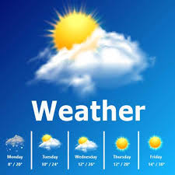
Weather Warnings and Precautions

Slide 28
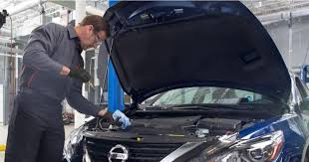
Regular Vehicle Maintenance

Slide 29
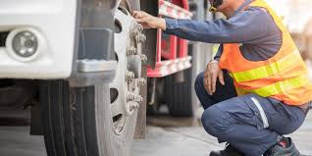
Pre-Trip Inspections

Slide 30
Adhering to Speed Limits

Slide 31

Avoiding Distractions

Slide 32

Alcohol and Drug Education

Slide 33

Combating Fatigue

Slide 34
Managing Traffic along Offa Township Road: Preventing Possible Dangers from Trailers
Extra precautions
To avoid accidents,
Given the size and potential hazards

Slide 35
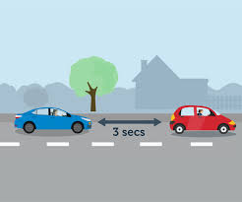
Maintaining a Safe Distance

Slide 36
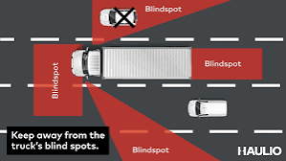
Avoiding Blind Spots

Slide 37
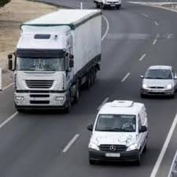
Passing Safely

Slide 38
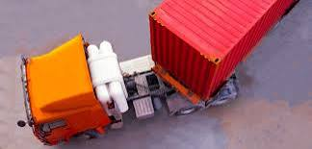
Anticipating Turns

Slide 39
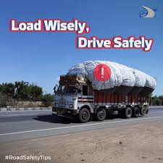
Being Cautious Around Unstable Loads

Slide 40
Conclusion
Crashes
Preventive measures + including proper road maintenance + vehicle care + responsible driving
=
reduce crashes.
Trailers on Offa roads;
Be cautious
Employ defensive driving techniques to prevent possible dangers.
Preventing road traffic crashes is not just the responsibility of the government but a collective duty of all road users.

